Slide 1

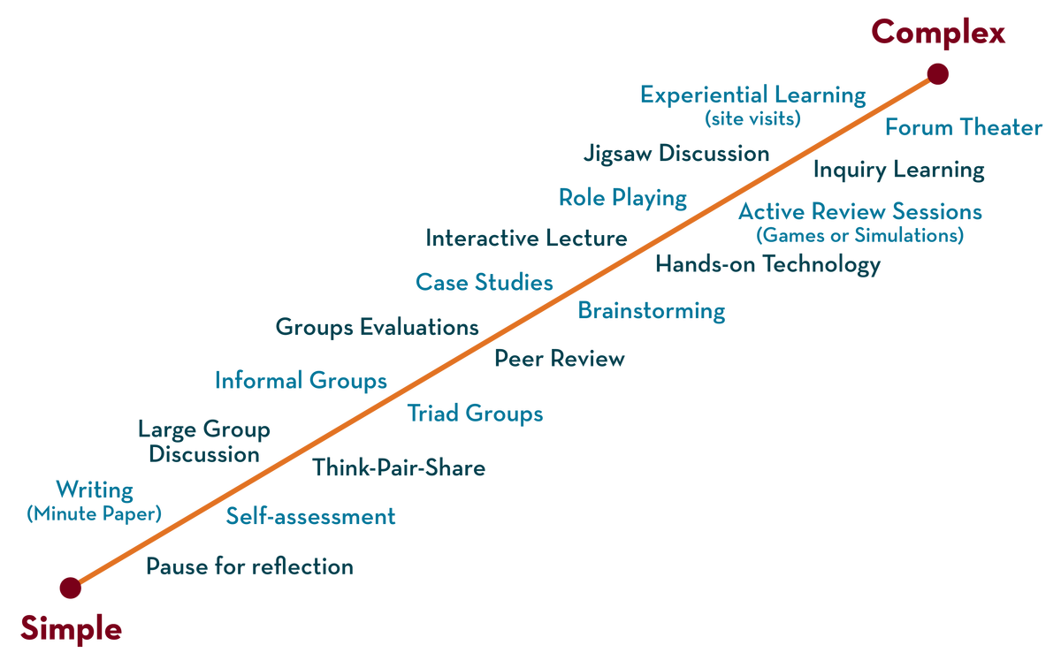
Inter-networking Devices: Distinguishing of Networking Devices and Inter-networking Devices
NETWORK PROTOCOLS & SECURITY
24EC2210
Topic:
Inter-networking Devices: Distinguishing of Networking Devices and Inter-networking Devices
Session – 12

Slide 2
Networking and Internetworking Devices

Slide 3
Connecting Devices
Networking Devices
Internetworking
Devices
Repeaters
Bridges
Routers
Gateways

Slide 4
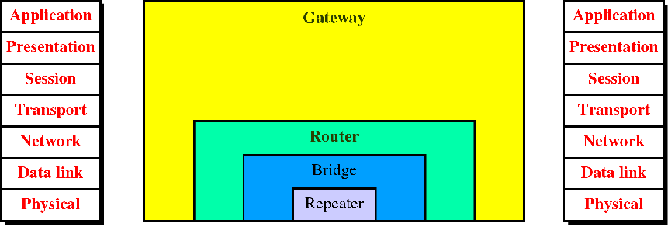
Connecting Devices
Hub
PASSIVE HUB

Slide 5
Connecting Devices
Those which operate below the physical layer such as a passive hub.
Those which operate at the physical layer (a repeater or an active hub).
Those which operate at the physical and data link layers (a bridge or a two-layer switch).
Those which operate at the physical, data link, and network layers (a router or a three-layer switch).
Those which can operate at all five layers (a gateway).

Slide 6
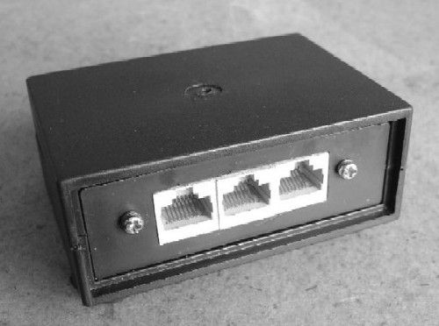
Passive Hub
A passive hub is just a connector. It connects the wires coming from different branches.
In a star-topology Ethernet LAN, a passive hub is just a point where the signals coming from different stations collide; the hub is the collision point.
This type of a hub is part of the media;

Slide 7
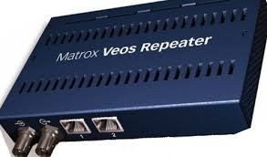
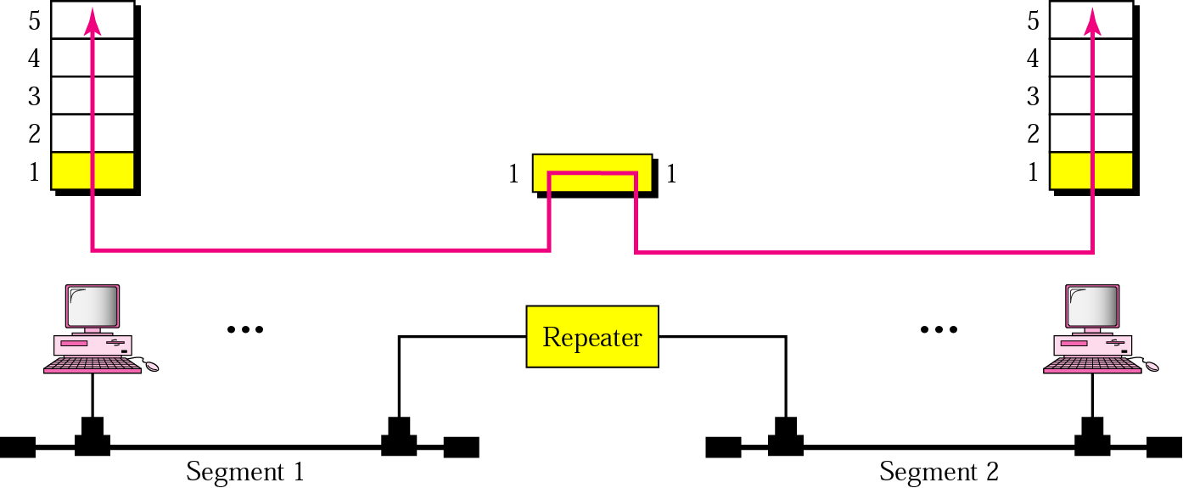
Repeater
Extend the physical length
No network function has been changed
Location is matter
Connects two segments of the same LAN

Slide 8
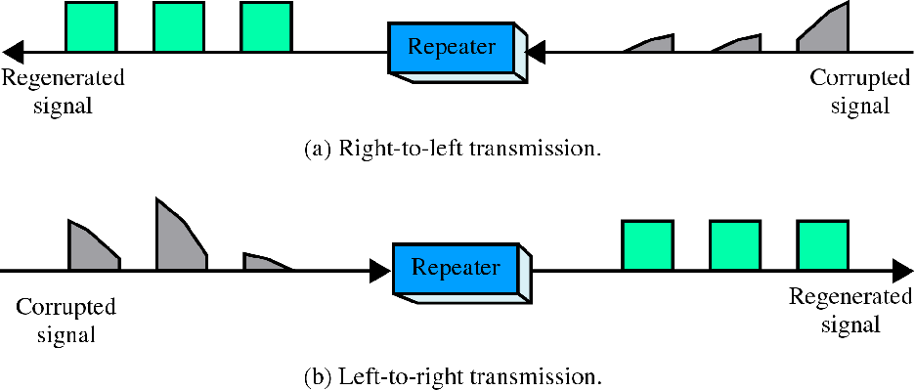
Function of repeater
Repeater is not exactly as same as Amplifier

Slide 9
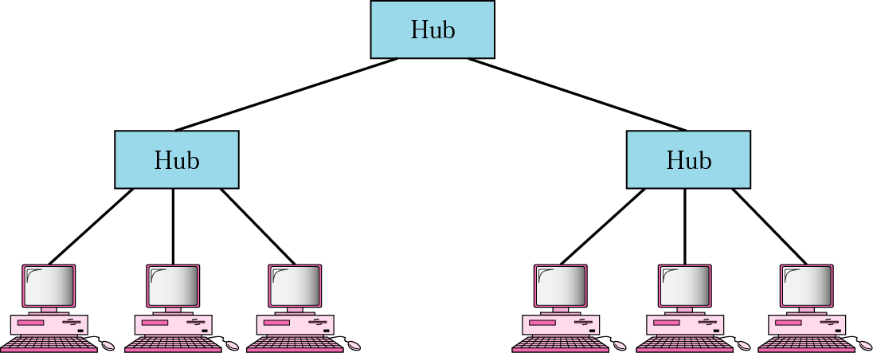
Active Hub
Actually is a multiport repeater
Used to create connections between stations in a physical Star / Tree Topology

Slide 10
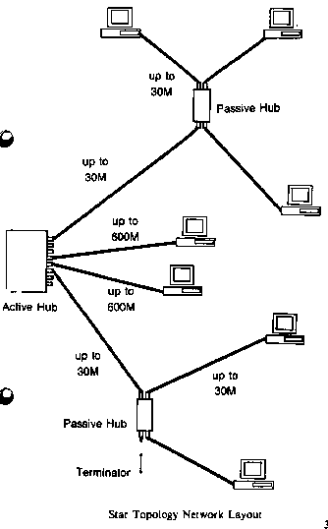
Active hub

Slide 11
Bridge
Divide a large network into smaller segment
Isolating and controlling the link problems (e.g. congestion)
Regenerate signal + Checking Physical Address and forward only to the specified segment

Slide 12
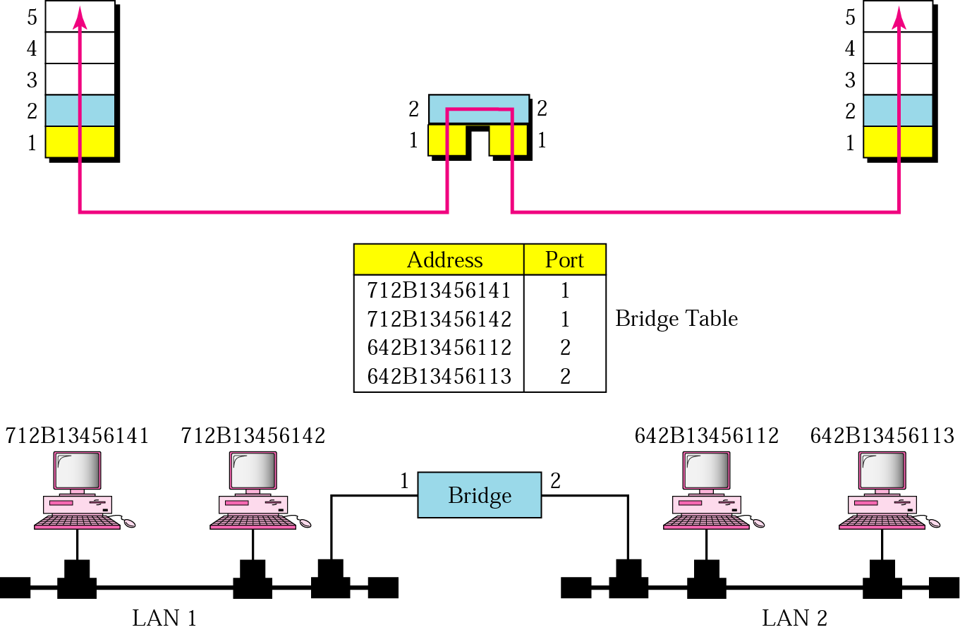
Bridge

Slide 13
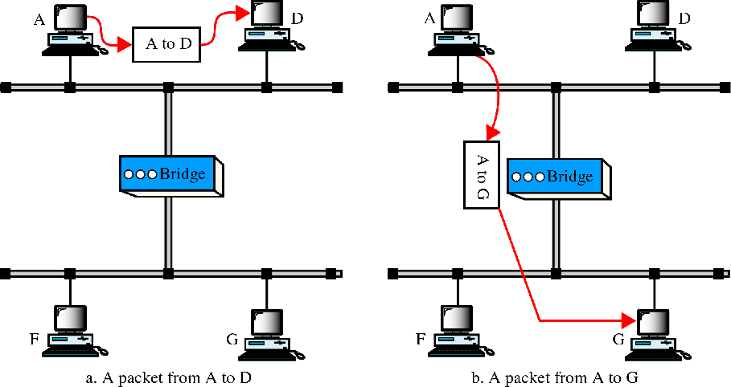
Function of a bridge

Slide 14
Bridge
A bridge has filtering capability. It can check the destination address of a frame
Decide if the frame should be forwarded or dropped.
If the frame is to be forwarded, the decision must specify the port.
A bridge has a table that maps addresses to ports.
A bridge does not change the physical (MAC) addresses in a frame.

Slide 15
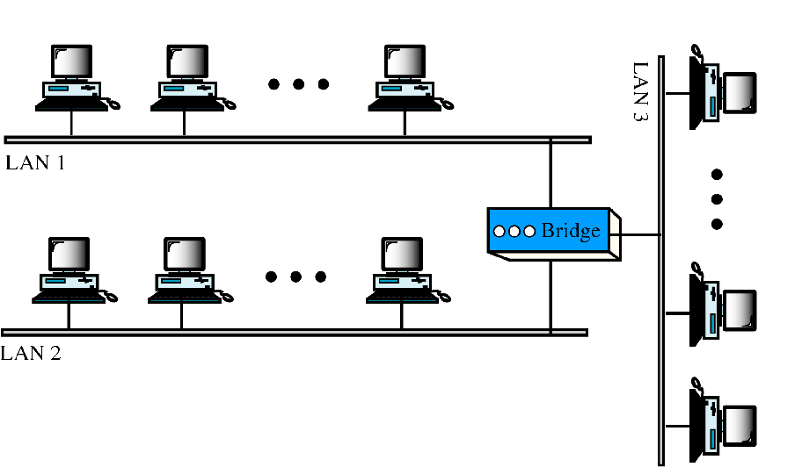
Multiport bridge

Slide 16
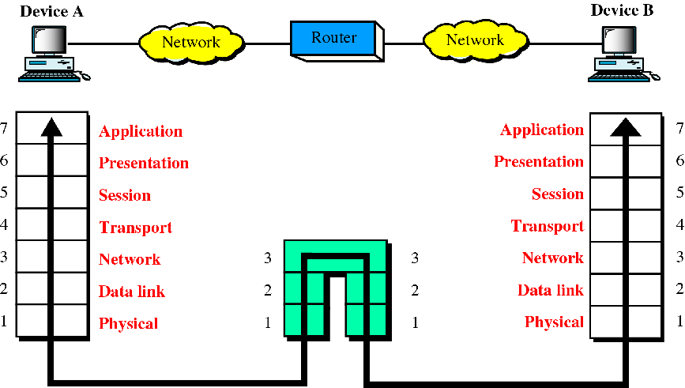
Routers

Slide 17
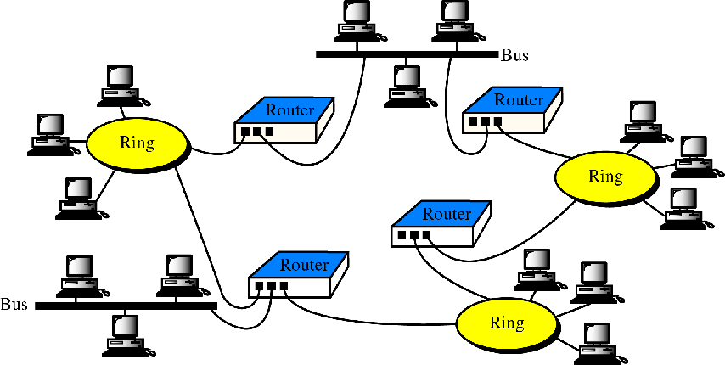
Routers in an internet

Slide 18
Routers
Act like stations on a network
Multi-home
Definition (Goal)
  “Learning how to get from here to there."
  “Process of discovering, selecting, and employing paths from one place to another (or to many others) in a network” [from David M. Piscitello, Bellcore and A. Lyman Chapin, BBN]

Slide 19
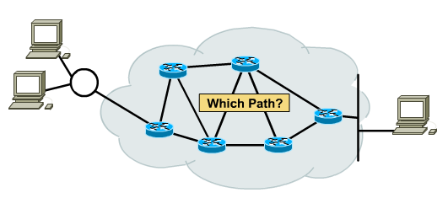
Routing Principle
Goal: Arriving at the destination
Considerations:
  Direct route (shortest)
  Reliable route
  Cheap route
  Safe route
  Scenic route ☺

Slide 20
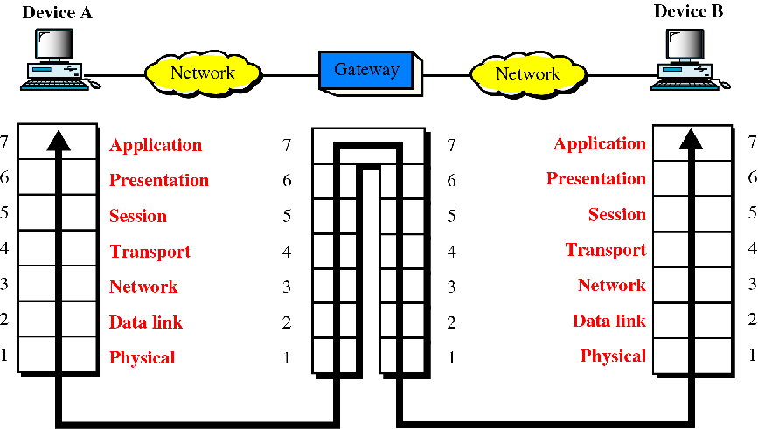
Gateways (protocol converter)

Slide 21
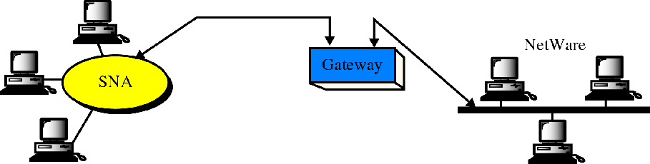
A gateway
SNA network (IBM)
Netware network (Novell)

Slide 22
A gateway
A gateway is normally a computer that operates in all five layers of the Internet or seven layers of OSI model.
A gateway takes an application message, reads it, and interprets it.
it can be used as a connecting device between two internetworks that use different models.
A network designed to use the OSI model can be connected to another network using the Internet model.

Slide 23
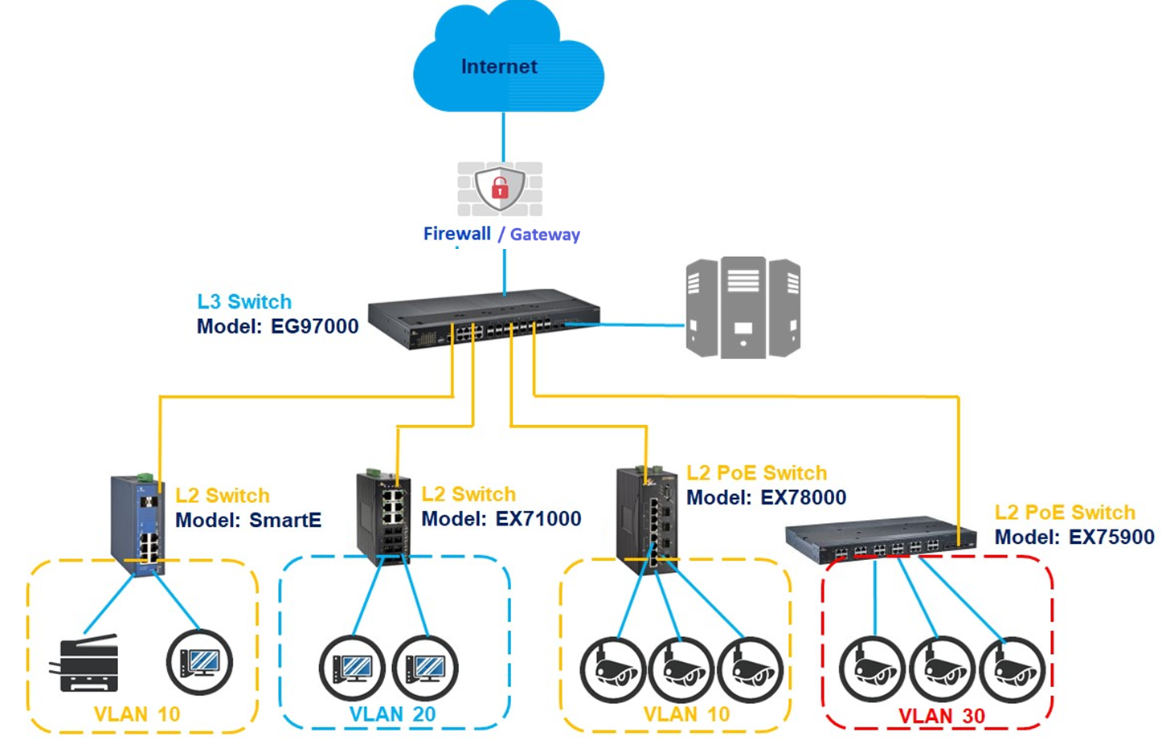

Slide 24

SUMMARY
Networking devices
Internetworking devices

Slide 25
TERMINAL QUESTIONS
Describe in detail the working of different network and internetworking devices.
Clearly demonstrate the functionality of a bridge.

Slide 26
REFERENCES FOR FURTHER LEARNING OF THE SESSION
Reference Books:
Behrouz A. Forouzan , “Data Communication and Networking”, TMH, 5th Edition, 2012.
A.S. Tanenbaum, David J. Wetheral “Computer Networks” Pearson, 5th Edition.

Slide 27
THANK YOU
Team – Network Protocols & Security

